Slide 1
BALANCE OF NATURE
By MbwamboJr 2019

Slide 2
Environment
Natural environment is composed of all living and non-living things that occurs naturally on earth. It includes such things as air, water, animals, plants, micro-organisms, stones and rocks, soil, clouds and the sun.
By definition, environment refers to everything that surrounds an organism and influence/affects it

Slide 3
Components of Natural Environment
Natural environment is composed of two main components. These are:
Biotic factors/components
Abiotic factors/components

Slide 4
Biotic Component
Biotic component is composed of all living components of the environment. It include plants, animals, fungi and micro-organisms.
At any time, an organism is affected by biotic factors of an environment. These can be either population or community based factors.

Slide 5
Population Factors
Population density: that is, the number of organisms of a particular species in a given area.
Dispersion: that is, geographical distribution of organisms in a given area.
Age structure: this refers to the geographical distribution of organisms according to their age.
The ratio of males to females
Number of births (natality rate)
Number of deaths (mortality rate)
Population growth: that is, the rate at which the number of organisms is increasing

Slide 6
Community Factors
Food chain.
Food web

Slide 7
Abiotic Component
Abiotic component refers to all non-living components of the environment which includes light, water, air rocks and soil.
At any time, an organism is affected by biotic factors of an environment. These can be climatic, aquatic, soil or geographical

Slide 8
Climatic Factors
Temperature. Organisms tend to adapt themselves to the changing temperature conditions of the environment. E.g. shedding of leaves by plants during hot seasons to reduce rate of heat loss through transpiration; deposition of fat layer under the skin by animals in very cold areas.
Light. Mostly obtained from the sun, affects processes such as germination, opening and closing of stomata, flowering, and photosynthesis in plants

Slide 9
Climatic Factors
Wind. This affects the rate of transpiration in plants as well as the process of rain formation
Atmospheric pressure. This is the force exerted on the earth’s surface by the weight of air. High atmospheric pressure increases the concentration of oxygen and carbon dioxide which in turn affects the rate of gaseous exchange in organisms.
Water. This serves as a habitat for a variety of aquatic organisms. It also serves as a solvent, a medium of transpiration in plants as well as temperature regulator in organisms

Slide 10
Aquatic Factors
Salinity. This refers to quantity of salts dissolved in water. Some aquatic organisms are adapted to live in freshwater while others are adapted in saltwater habitats.
Wave action. This causes movement of water in oceans, seas and lakes. This affects distribution of organisms in water bodies. E.g. organisms like shrimps crabs and clams are found in intertidal zones where they are covered by water during high tide and exposed to air during low tide

Slide 11
Soil Factors
Soil texture. This refers to the size of soil particles. E.g. clay soil has very fine particles, loam soil has equal amounts of large and fine particles while sand has large particles. This affects drainage system of the soil and hence fertility and distribution of plants.
Soil pH. That is, the degree of acidity or alkalinity of the soil. Some plants are adapted to live in acidic soils (e.g. tomatoes) while others are adapted to live in alkaline soils (e.g. onions and cabbage)

Slide 12
Geological factors
Altitude. This refers to the height above sea level. At high altitudes atmospheric pressure, temperature and oxygen concentration are generally lower while wind speed and rainfall are higher than at low altitudes. This affects distribution of organisms.
Geological substratum. This refers to types of rocks that disintegrates to form the soil in an area. The chemical composition of the soil is affected by the nature of parent rocks, which in turn determines soil pH and soil fertility.
Slope. This is the gradient of land. It affects the rate of soil erosion, which in turn affects distribution of nutrients in the soil for plant growth

Slide 13
Other Factors
Pollutants. These are substances that contaminates the environment. E.g. gas, liquid and solid pollutants. These can cause diseases, retardation or death of organisms.
Camouflage. This refers to the physical similarity between an organism and its surroundings/habitat. It enables an organism to conceal itself in order to avoid predators or to approach its prey

Slide 14
Key Terms Used in Balance of Nature
Ecology: this is the scientific study of interactions between living organisms and their environment.
Autecology: this is the study of an individual species in relation to its environment.
Population: refers to the total number of organisms of the same species occupying a particular habitat at a given time.
Community: this refers to group of organisms of different species living together in a specific area called habitat.
Habitat: this is a specific area with a specific set of conditions that appropriate for a certain species of organisms to live

Slide 15
Key Terms Used in Balance of Nature
Niche: refers to a position occupied and role played by a particular species of organisms in a given habitat.
Ecosystem: this is a natural unit composed of living and non-living things whose interaction brings about a self-sustaining system.
Food chain: this is a simplified diagrammatic representation of a feeding relationship between organisms in an ecosystem in which each organism is eating or being eaten once.
Food web: refers to a complex diagrammatic representation of a feeding relationship between organisms in an ecosystem in which each organism is eating or being eaten more than once

Slide 16
Interaction among Living Organisms

Slide 17
Types of Interactions
Organisms’ interactions can be classified into three main types. These are:
Predation
Competition
Symbiosis

Slide 18
Predation
Predation is a feeding interaction between two or more organisms in which one organism hunts, capture and kill another organism for food.
Predator is an organism that hunts, capture and kill another organism for food (e.g. lion, leopard and eagle) while prey is an organism which is hunted, captured and killed by another organism for food (e.g. antelope, zebra and wild beast

Slide 19
Competition
Competition is the feeding interaction whereby two or more organisms requires the same limited environmental resources for their survival. E.g. Leopards and Lions both hunts antelopes and zebra.
The competition can be intraspecific (competitors are of the same species) or interspecific (competitors are of different species)

Slide 20
Symbiosis
This is a closely feeding relationship between two organisms of different species.
There are several forms of symbiosis as explained hereunder:
Mutualism
Commensalism
Parasitism

Slide 21
Mutualism
This is a close feeding relationship between two organisms of different species in which both organisms benefit from the relationship.
For example, rhizobium bacterium in the root nodules of legumes fix free nitrogen gas into nitrates for use by the plant while the plant provides shelter and protection for the bacteria

Slide 22
Commensalism
This is a feeding interaction between two organisms of different species in which one organism benefits from the relationship while the other is neither benefitting nor getting harmed.
For example, birds building a nest in a hole in a tree

Slide 23
Parasitism
This refers to a feeding interaction between two organisms of different species in which one organism benefits while the other is being harmed by the interaction.
For example; plasmodium, a malaria causative agent in humans

Slide 24
Food web and food chain
Food web is a complex diagrammatic representation of a feeding relationship between organisms in an ecosystem in which each organism is eating or being eaten more than once.
Food chain is a simplified diagrammatic representation of a feeding relationship between organisms in an ecosystem in which each organism is eating or being eaten once
Each organism in a food web or chain represents a trophic level. Trophic level is a position occupied by an organism in a food web or food chain.

Slide 25
Trophic Levels
The food web or food chain always starts with producers, that is, the organism that can manufacture its own food. E.g. green plants and photosynthetic bacteria
Producers are followed by primary consumers, that is, herbivores which eats producers. E.g. rabbits, cows, buffalos, wildebeests, goats and sheep.
Primary consumers are followed by secondary consumers, which are mostly carnivores that eat herbivores. E.g. domestic cats, dogs, hyenas, lions, leopards and cheetahs

Slide 26
Trophic Levels
Secondary consumers can be followed by tertiary consumers which feed on secondary consumers; then quaternary consumers which feed on tertiary consumers.
The final in the list is the decomposer which feed on dead organic matter and break it down in the process that is referred to as decomposition.

Slide 27
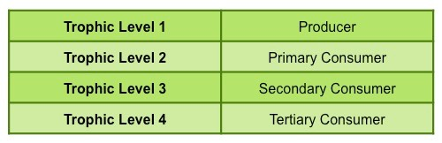
Trophic Levels

Slide 28
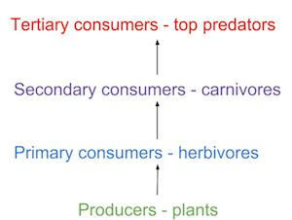
Trophic Levels

Slide 29
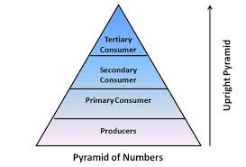
Trophic Levels
It is important to note that, as you move from the producers to the top consumers, the population tends to decrease

Slide 30
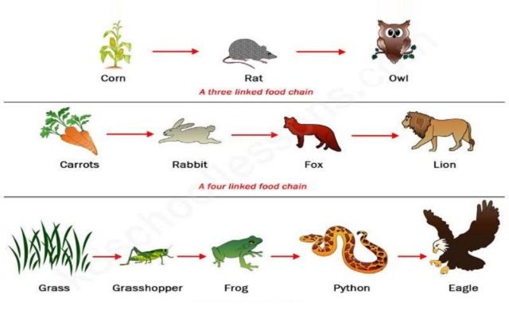
Example of food chain

